Slide 1
PRICE PREDICTION (HOUSING PROJECT)
Submitted by:
Vijaya Mukati

Slide 2
INTRODUCTION
Surprise Housing is a US based Real estate and housing company who is trying to entry into Australian Real estate market. The company is looking at prospective properties to buy houses to enter the market. We are required to build a model using Machine Learning in order to predict the actual value of the prospective properties and decide whether to invest in them or not.
For this Surprise Housing wants to know:
• Which variables are important to predict the price of variable?
• How do these variables describe the price of the house

Slide 3
Contents
Analytical Problem Framing.
EDA
Visualizations and Insights.
Creating Pre-Processing Pipeline Function.
Model/s Development and Evaluation
Run and evaluate selected models.
Visualizations of model performance.
CONCLUSION.

Slide 4
Insights from the Data.
From all the Data available, we can bring out some neat insights or conclusions such as
✓ How the location of the lot decides the selling price of the property.
✓ How the amenities like Garages, Swimming pool, parking lot, fence type, insulation type and quality increase the selling prices.
✓ How the number of rooms directly increases the cost and size of the property.
✓ What is the type of building and the year built mostly comes for the sales?
✓ The year the building build versus the cost of the property.
✓ The year the modified versus the cost of the property.
✓ Nearby neighborhood versus cost of the property.

Slide 5
Tools Used. (Hardware and Software Requirements).
1. Python 3.8
2. NumPy
3. Pandas
4. Matplotlib
5. Seaborn
6. Data science
7. Machine learning
8. CPU with RAM of 8GB
9. Anaconda Environnent
10. Jupyter Notebook

Slide 6
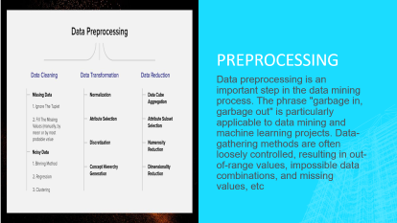
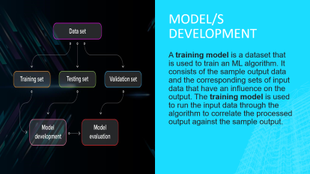
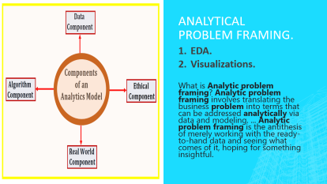

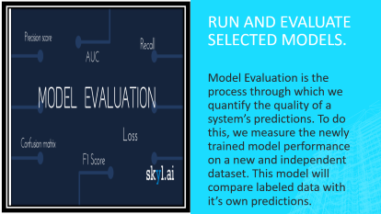
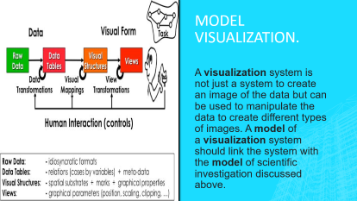
Key Findings

Slide 7
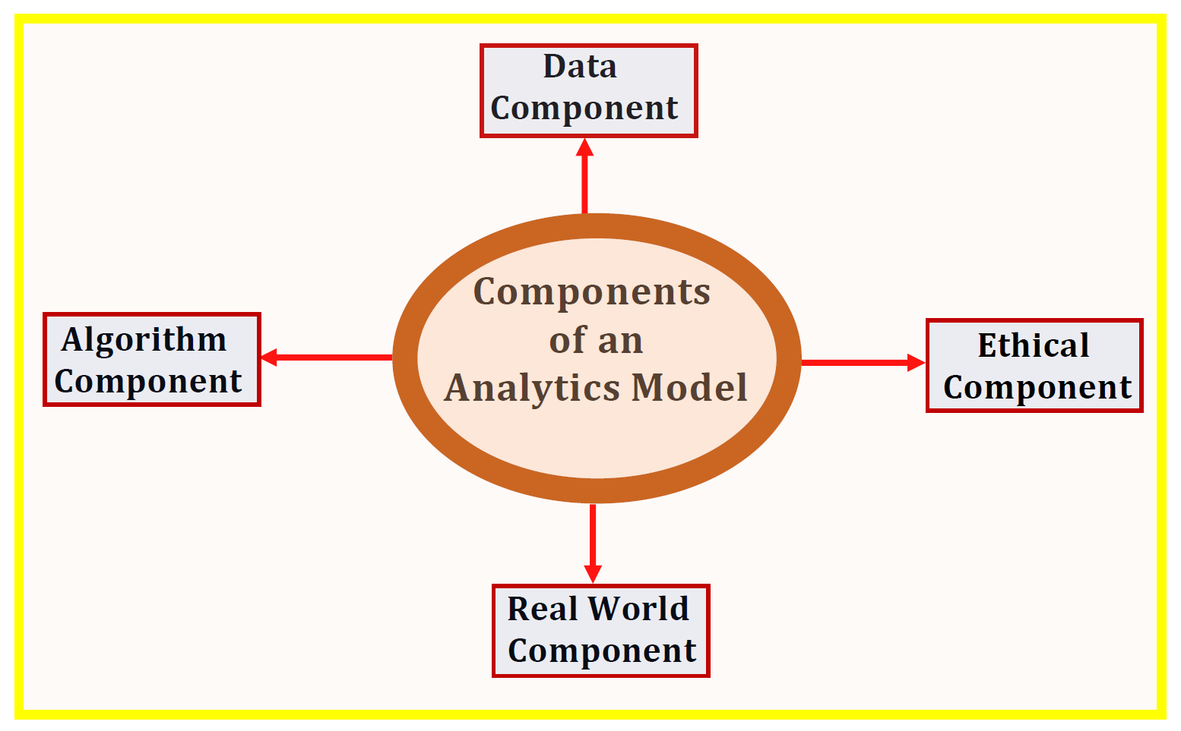
Analytical Problem Framing.
EDA.
Visualizations.
What is Analytic problem framing? Analytic problem framing involves translating the business problem into terms that can be addressed analytically via data and modeling. ... Analytic problem framing is the antithesis of merely working with the ready-to-hand data and seeing what comes of it, hoping for something insightful.

Slide 8
Exploratory Data Analysis & Visualization
01. Univariate Analysis
02. Multivariate Analysis
03. Correlation of Dataset
Univariate analysis is the simplest form of analyzing data. “Uni” means “one”, so in other words your data has only one variable.
Multivariate analysis is a set of statistical techniques used for analysis of data that contain more than one variable.
Correlation is used to test relationships between quantitative variables or categorical variables.
04.Correlation with Target variable
05. Conclusion
Correlation with the target variable to know how the data is related.
Summary with the conclusion of all the analysis

Slide 9
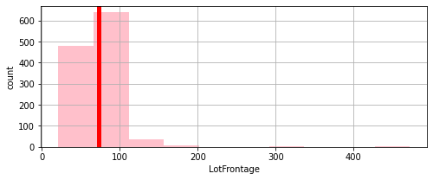
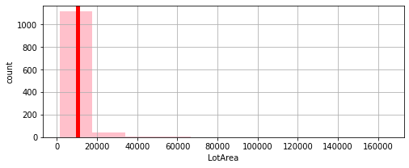
Univariate Analysis
MATHEMATICAL SUMMARY OF LotFrontage:
count 1168.000000
mean 72.678938
std 29.781705
min 21.000000
25% 60.000000
50% 70.000000
75% 80.000000
max 472.000000
Name: LotFrontage, dtype: float64
MATHEMATICAL SUMMARY OF LotArea:
count 1168.000000
mean 10484.749144
std 8957.442311
min 1300.000000
25% 7621.500000
50% 9522.500000
75% 11515.500000
max 164660.000000
Name: LotArea, dtype: float64

Slide 10
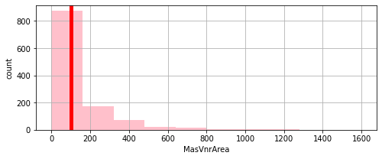
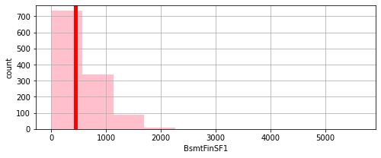
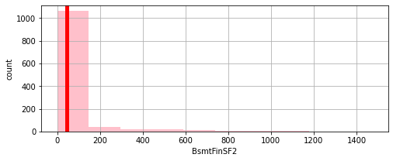
Univariate Analysis
MATHEMATICAL SUMMARY OF MasVnrArea:
count 1168.000000
mean 102.590753
std 182.168633
Min 0.000000
25% 0.000000
50% 0.000000
75% 160.000000
max 1600.000000
Name: MasVnrArea, dtype: float64
MATHEMATICAL SUMMARY OF BsmtFinSF1:
count 1168.000000
mean 444.726027
Std 462.664785
min 0.000000
25% 0.000000
50% 385.500000
75% 714.500000
max 5644.000000
Name: BsmtFinSF1, dtype: float64
MATHEMATICAL SUMMARY OF BsmtFinSF2:
count 1168.000000
mean 46.647260
std 163.520016
min 0.000000
25% 0.000000
50% 0.000000
75% 0.000000
max 1474.000000
Name: BsmtFinSF2, dtype: float64

Slide 11
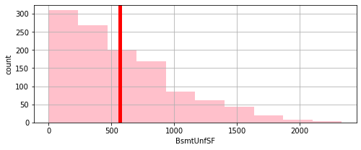
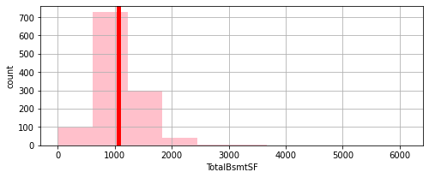
Univariate Analysis
MATHEMATICAL SUMMARY OF BsmtUnfSF:
count 1168.000000
mean 569.721747
std 449.375525
min 0.000000
25% 216.000000
50% 474.000000
75% 816.000000
max 2336.000000
Name: BsmtUnfSF, dtype: float64
MATHEMATICAL SUMMARY OF TotalBsmtSF:
count 1168.000000
mean 1061.095034
std 442.272249
min 0.000000
25% 799.000000
50% 1005.500000
75% 1291.500000
max 6110.000000
Name: TotalBsmtSF, dtype: float64

Slide 12
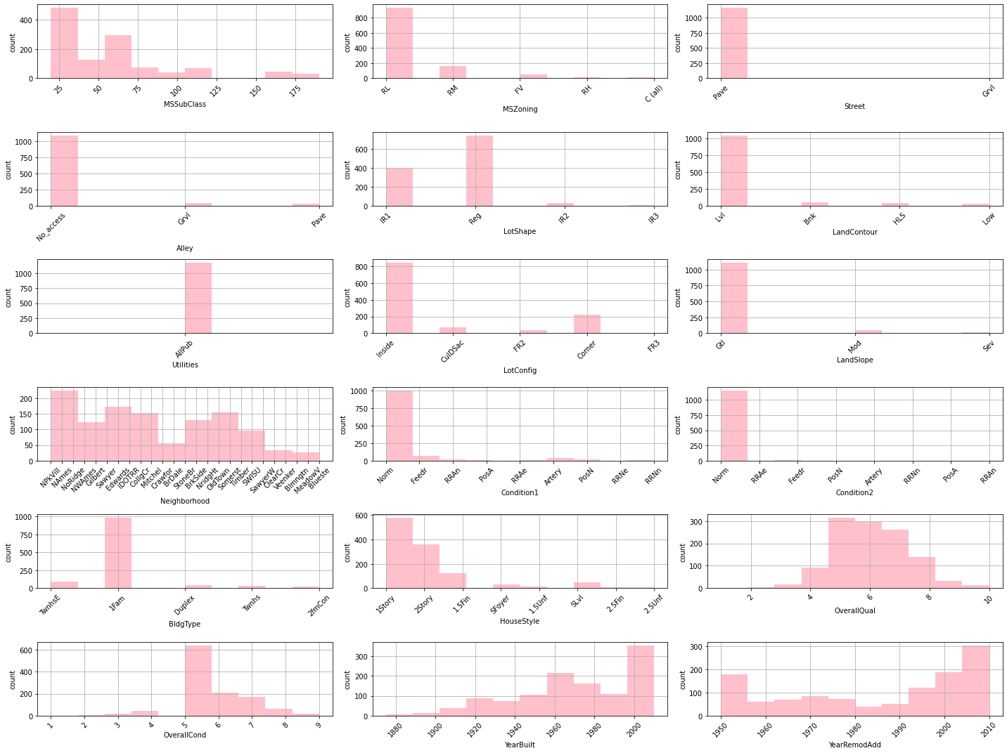
Univariate Analysis

Slide 13
KEY OBSERVATION: 1. Gable Roof type standard composite is high in number and exterior covering to house is Vinyl Siding and cement board. 2. Masonry veneer type is mostly none brick face, exterior quality and condition is mostly average/typical. 3. Cinder Block type foundation and basement quality is mostly good and condition is average/typical and basement mostly have no exposure. 4. basement finished type is mostly unfinished. 5. Gas forced warm air furnace heating type and Excellent in quality is high.

Slide 14
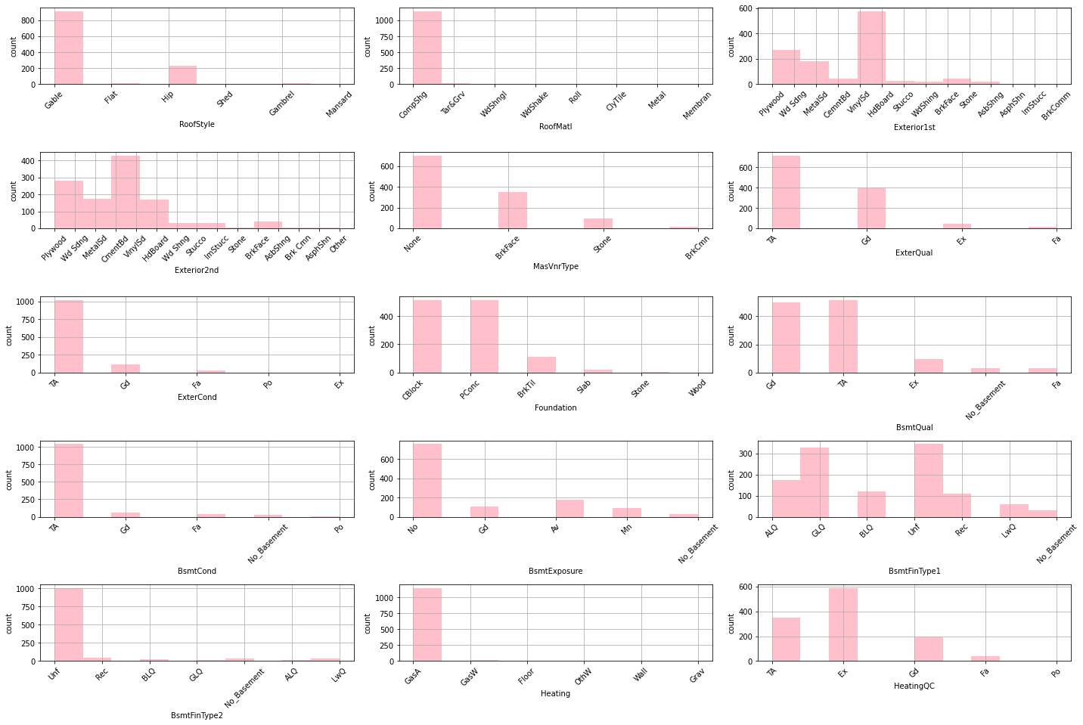
Univariate Analysis

Slide 15
Key observation:
Gable Roof type standard composite is high in number and exterior covering to house is Vinyl Siding and cement board.
Masonry veneer type is mostly none brick face, exterior quality and condition is mostly average/typical.
Cinder Block type foundation and basement quality is mostly good and condition is average/typical and basement mostly have no exposure.
basement finished type is mostly unfinished.
Gas forced warm air furnace heating type and Excellent in quality is high.

Slide 16
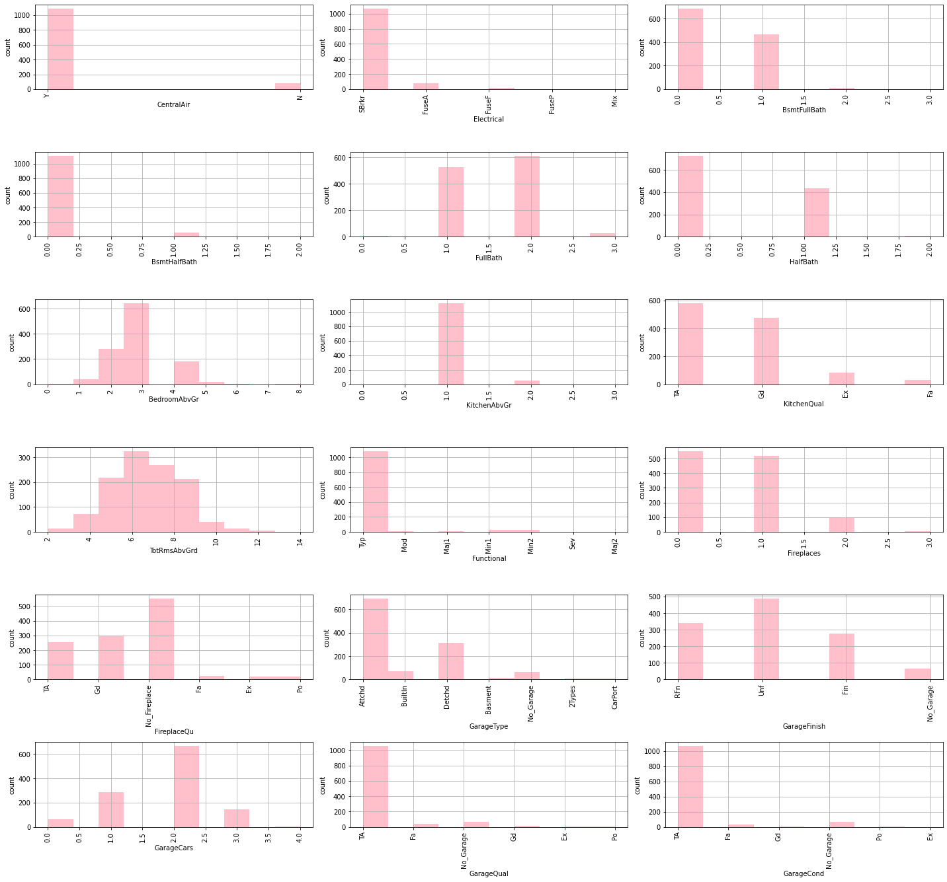
Univariate Analysis

Slide 17
Key observation:
Property mostly has central air conditioning with mostly electrical system of Standard Circuit Breakers & Romex
2. Kitchen Quality is mostly Typical/Average. home functionality is mostly Typical Functionality and fire place is between 0-1.
3. Garage type is attached and mostly unfinished 2 cars parking quality and condition is Typical/Average.

Slide 18
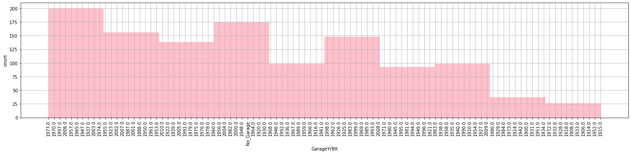
Univariate Analysis
Key Observation:
Properties out for sale are mostly built in year 1977, 1970. 1997, 2006, 1957, 1965, 1947, 1937, 2003, 1974.. which means from 1945 to 2006 in all frequency we have properties largely out for sale.

Slide 19
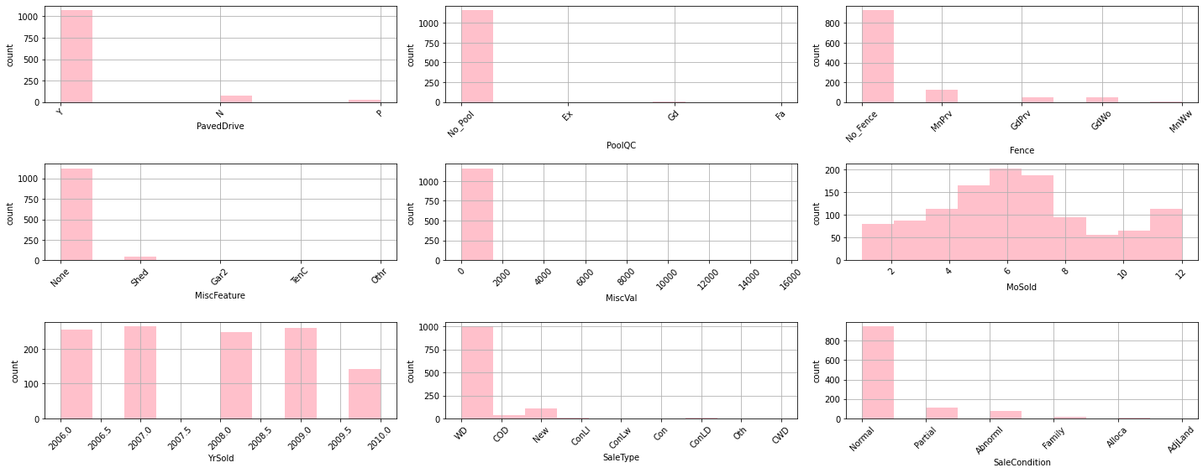
Univariate Analysis

Slide 20
Key observation:
1. Paved driveway is mostly Paved.
2. Sales type is Warranty Deed - Conventional condition is normal year sold is mostly 2007 with no fence and no pool.

Slide 21
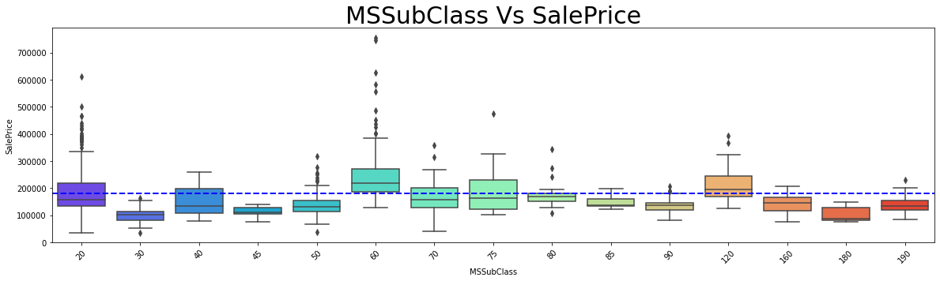
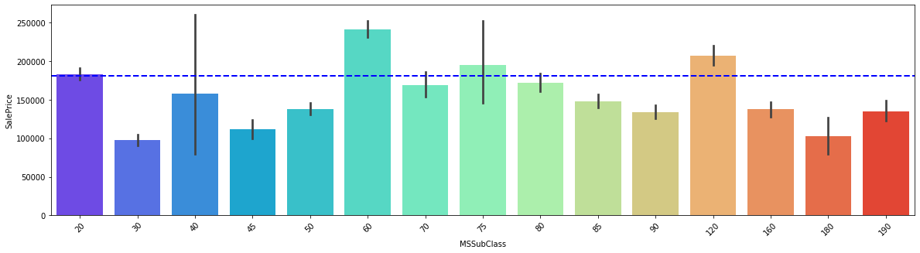
Multivariate Analysis

Slide 22
Key observation:
1. We can see that MSSubClass 60 – [2-STORY 1946 & NEWER] and 70- [2-STORY 1945 & OLDER] is the highest segment of building that is sold in the marker which means buyers mostly wish to buy these dwelling in the market

Slide 23
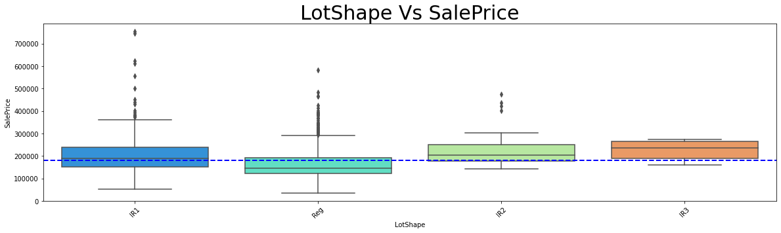
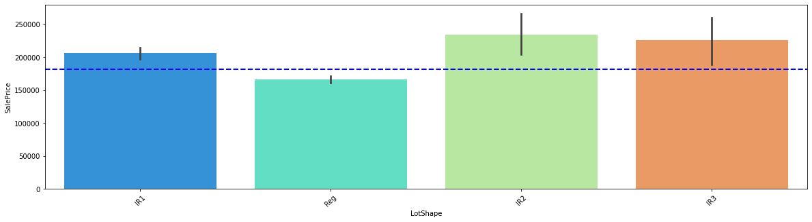
Multivariate Analysis

Slide 24
Key observation:
1. IR1 - Slightly irregular being the costliest lot shape followed by Reg – Regular.
2. IR2 - Moderately Irregular are the highest sold lot shape.
So, from above we can understand people are mostly interested in buying irregular shaped lot more than the regular shaped lot and since people are not buying the regular shaped lot the cost of the regular shaped lot is lesser than slightly irregular plot. And also the availability of the Regular shaped plot is lesser that might be also one of the reason to note.

Slide 25
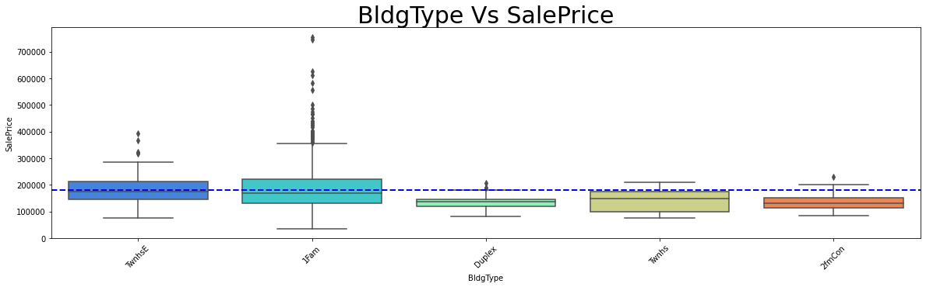
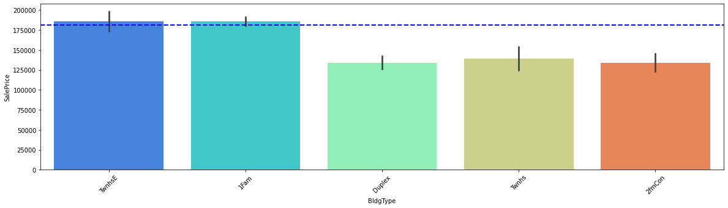
Multivariate Analysis

Slide 26
Key observation:
We can see one family type building being the costliest in the market and also getting sold higher.
2. TwnhsE - Townhouse End Unit is second highest sold Building Type.

Slide 27
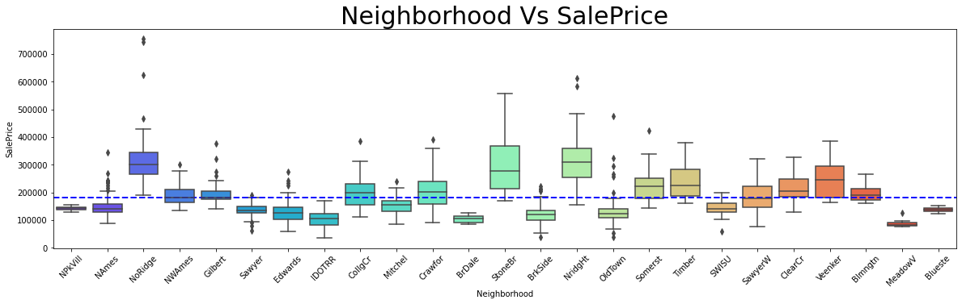
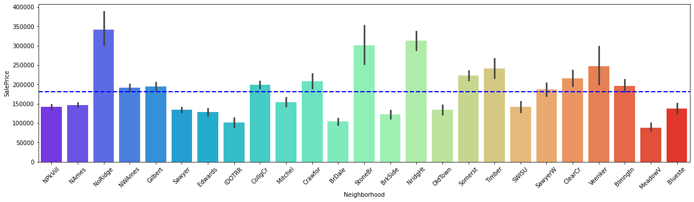
Multivariate Analysis

Slide 28
Key observation:
According to the Neighborhood NoRidge that is Northridge is being sold high and also costliest in the market.
2. NridgHt - Northridge Heights is the next costliest sold property with respect to neighborhood.

Slide 29
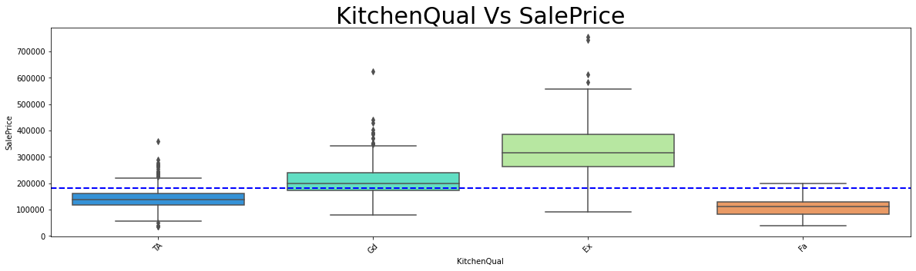
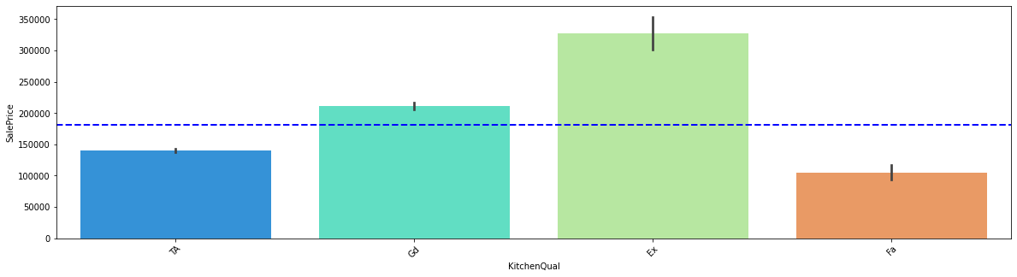
Multivariate Analysis

Slide 30
Key observation:
1. There was a saying the Quality of the kitchen is the beauty of the house, as similar to that we can see the excellent quality in kitchen will increase the cost of the property.
2. And also, the excellent quality of kitchens is being mostly build.
3. Good Quality in kitchen stands second in the order and also in number of units sold.
From above we can narrate a story that people mostly preferred good quality kitchens and also good and excellent quality of kitchens are being costlier.

Slide 31
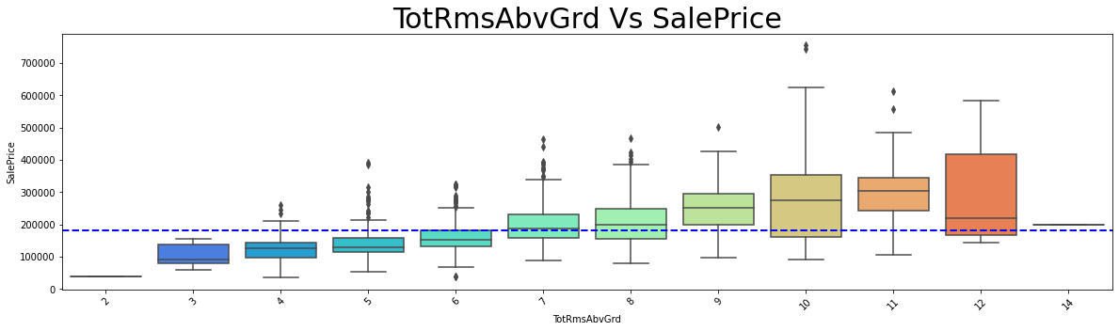
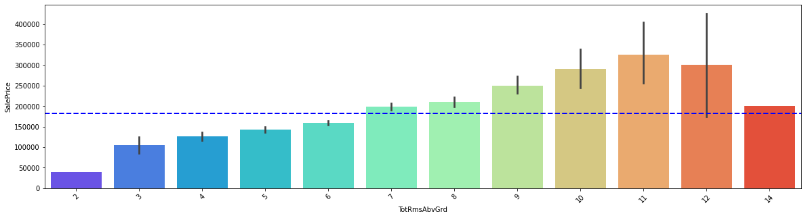
Multivariate Analysis

Slide 32
Key observation:
We can observe that the increase in number of rooms also increases the cost of the property, the highest sold property is 11 and 12 rooms property.
2. And costliest of the properties is 10 rooms sold property.

Slide 33
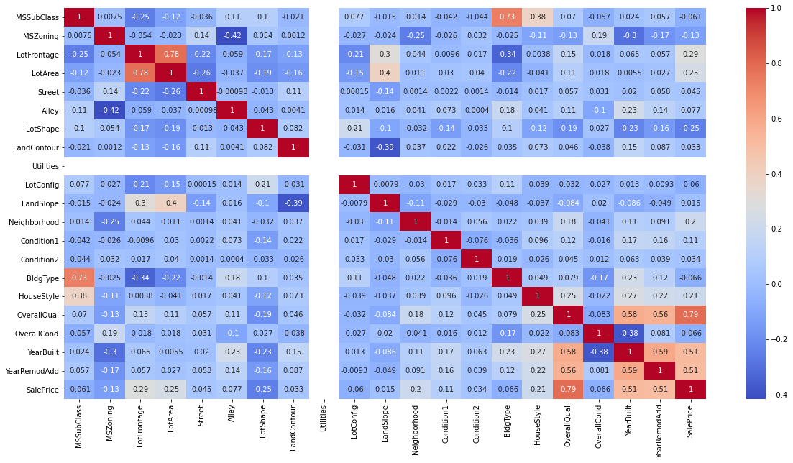
Correlations - 1

Slide 34
Key observation:
1. Since Utilities have only one values in all the columns it has no correlation. we will drop this column since it won’t help in building the model.
2. The table have more positive correlation at the bottom. Overall Quality yearbuilt year remodified have high corelation with sales prize.

Slide 35
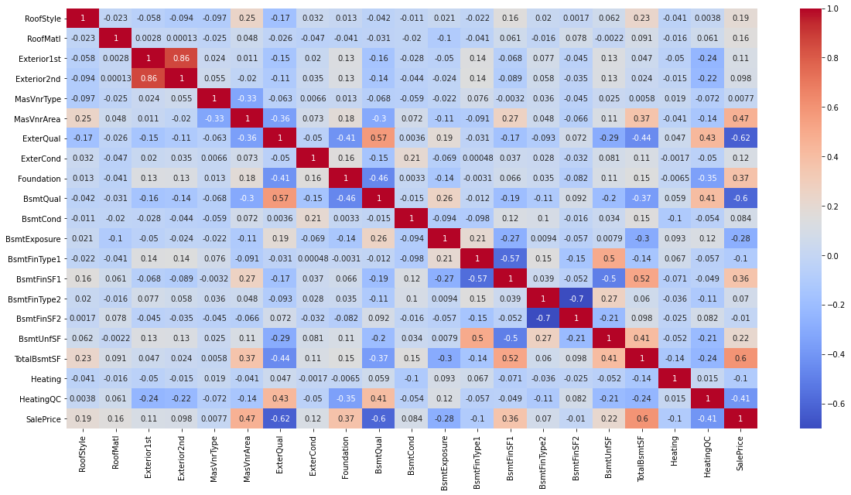
Correlations - 2

Slide 36
Key observation:
1. We can observe the feature variable have lesser correlation among themselves but they have high correlation with target variable.
2. Exterior1st and Exterior2nd have high correlation with themselves to avoid multicollinearity we will drop Exterior2nd.
3. The feature variables have high positive al well as negative correlations as we know that positive correlation increases the price od the property and the negative correlation will reduce the price of the property.

Slide 37
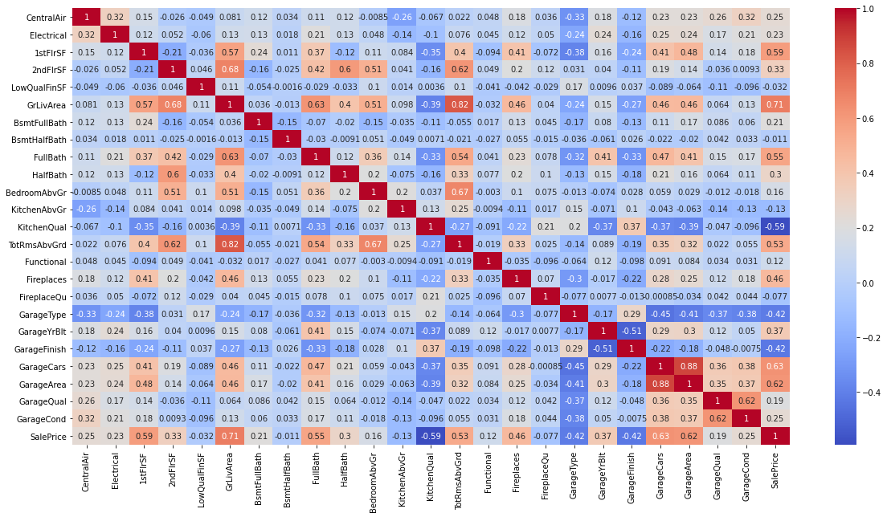
Correlations - 3

Slide 38
Key observation:
1. We can observe according to the correlations the scatterplot points are distributed.
2. We can see high positive correlation of feature variables with the sales prize.
3. We can see Garage Area, garage cars, garage area built, Fireplace, total rooms available, full bath, living area, 1stFlrSf are more positive corelated which means the increase in the above will also increased the cost and selling price of the property.
4. KitchenQual, Garagetype, GarageFinish are negatively correlated and the increase in that will decrease the cost and the selling price of the property. 5. We also can see there are multiple variable those have more correlation among themselves than the target variable these variables will create the multi collinearity problem. To overcome those problem, I am dropping one of those variables. 6. Garagecars, TotalrmsAbvGround can be removed to avoid multicollinearity.

Slide 39
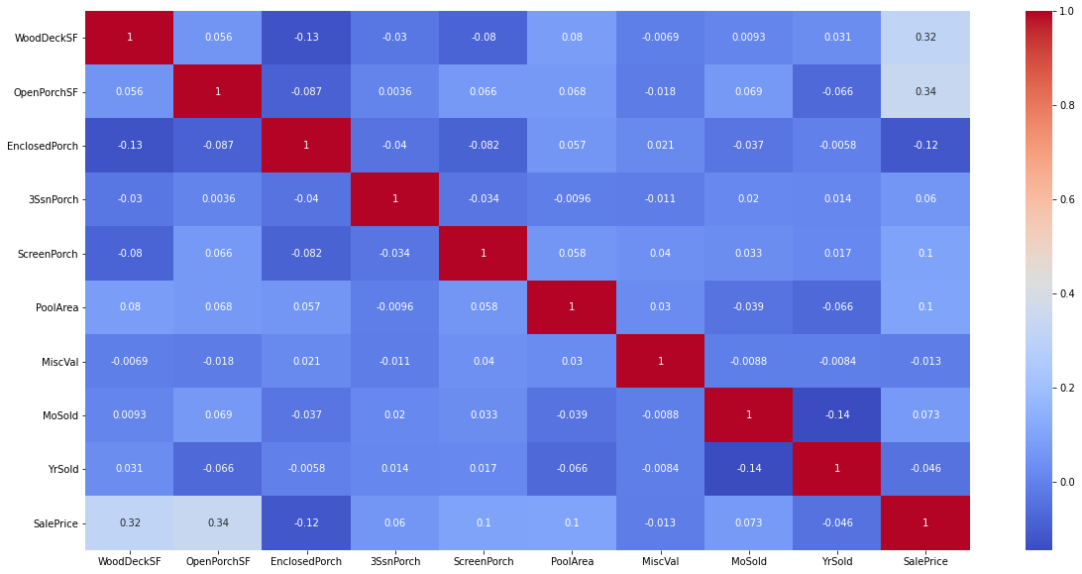
Correlations - 4

Slide 40
Key observation:
We can see more of a negative correlation in the with the target variable. 2. WoodsDeckSF and OpenPorchSF have high correlation with sales prize
From all the above analysis we can clearly chart the following points.

Slide 41
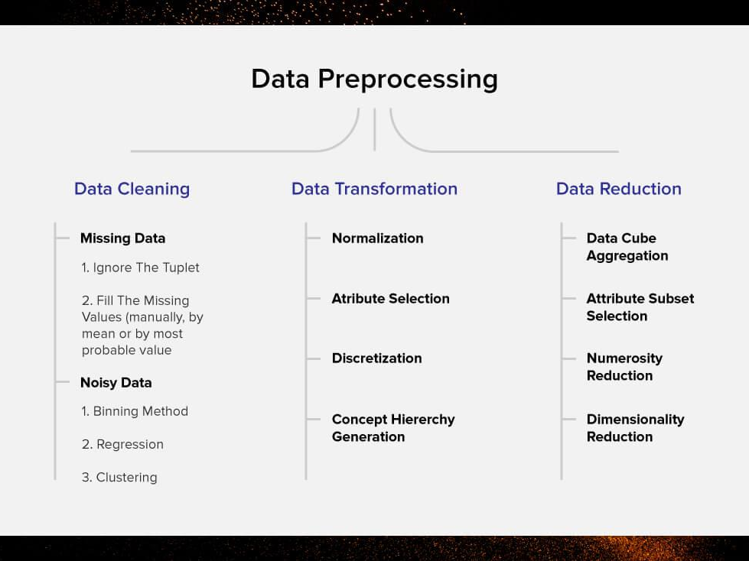
Preprocessing
Data preprocessing is an important step in the data mining process. The phrase "garbage in, garbage out" is particularly applicable to data mining and machine learning projects. Data-gathering methods are often loosely controlled, resulting in out-of-range values, impossible data combinations, and missing values, etc

Slide 42
Creating Pre-Processing Pipeline Function.
With all above collected information I have built a model to pre-process and power transform our data without much loss in data records and also in future same function can be also used in testing data to pre-process the testing data.
I have followed four steps in the pre-processing function (Data_preparation) these steps are as follows.
1. Dropping the unwanted columns or feature variables as per our observation ('Id', 'Utilities', 'Exterior2nd', 'GarageCars', 'TotRmsAbvGrd')
2. Imputing all the missing values.
3. Converting all the categorical columns into numerical values with the help of label Encoder.
4. Finally Transforming the data into small vectors with Power Transformation technique

Slide 43
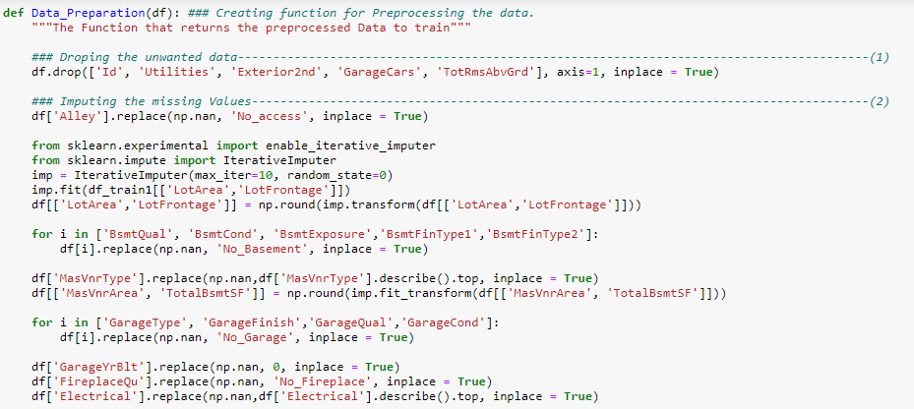
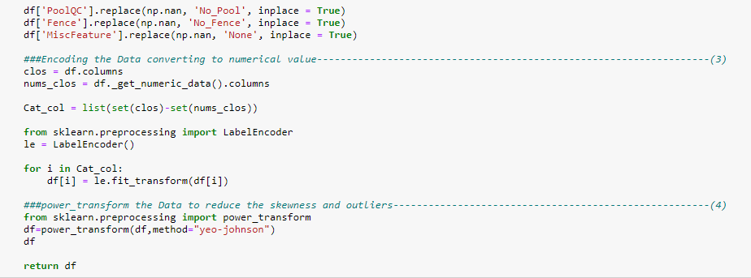
Creating Pre-Processing Pipeline Function.

Slide 44
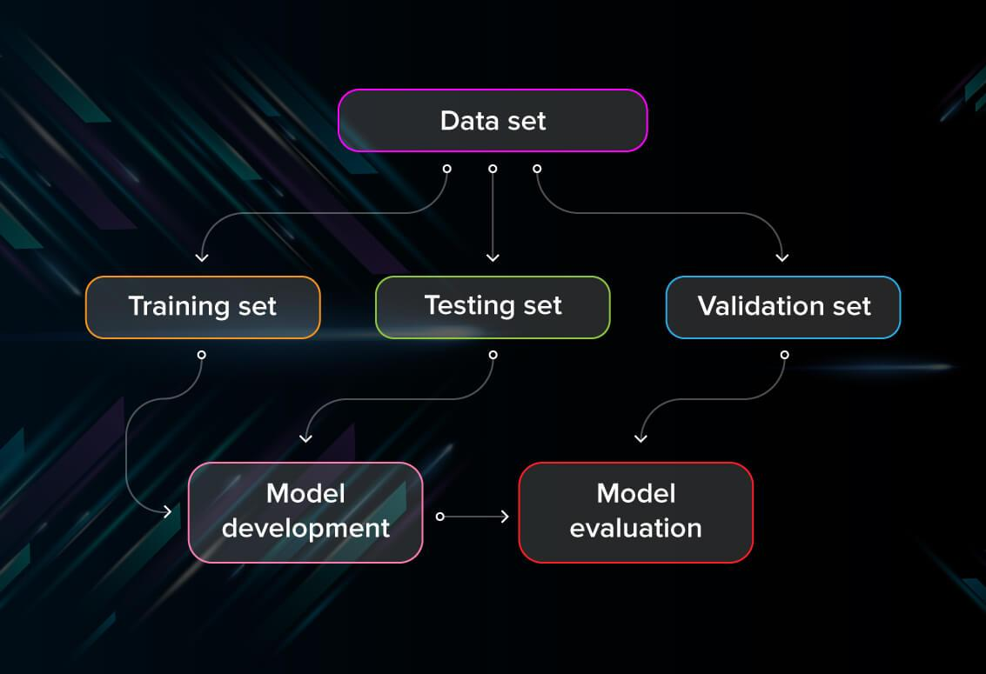
Model/s Development
A training model is a dataset that is used to train an ML algorithm. It consists of the sample output data and the corresponding sets of input data that have an influence on the output. The training model is used to run the input data through the algorithm to correlate the processed output against the sample output.

Slide 45
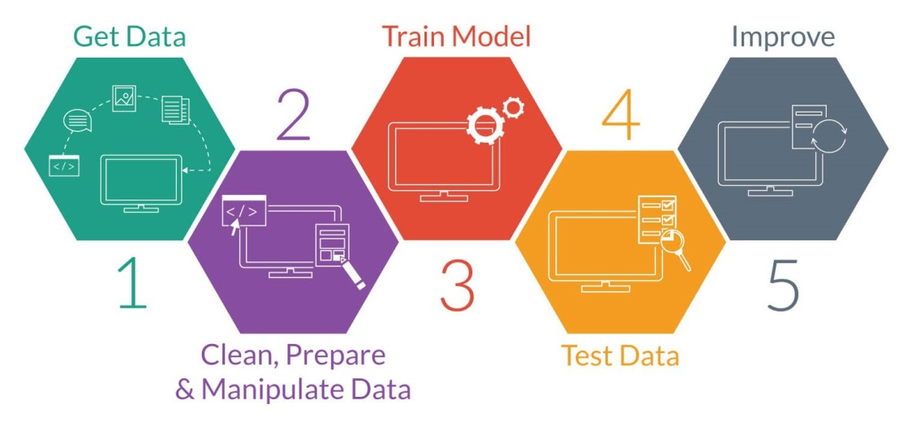
Testing of Identified Approaches (Algorithms)
List of Algorithms.
LinearRegression
Lasso
Ridge
ElasticNet
SVR
KNeighborsRegressor
DecisionTreeRegressor
AdaBoostRegressor
RandomForestRegressor
Model Training phases

Slide 46
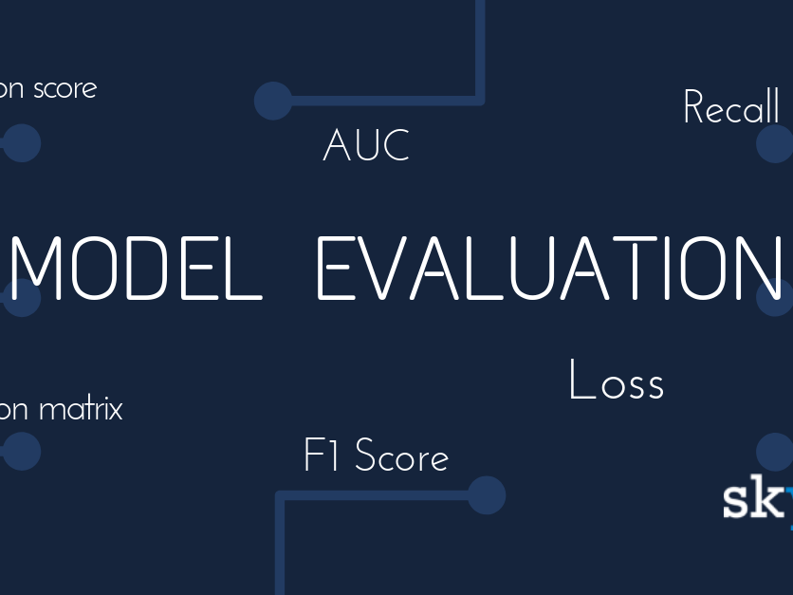
Run and evaluate selected models.
Model Evaluation is the process through which we quantify the quality of a system’s predictions. To do this, we measure the newly trained model performance on a new and independent dataset. This model will compare labeled data with it’s own predictions.

Slide 47
Model evaluation performance metrics teach us:
How well our model is performing
Is our model accurate enough to put into production
Will a larger training set improve my model’s performance?
Is my model under-fitting or over-fitting?

Slide 48
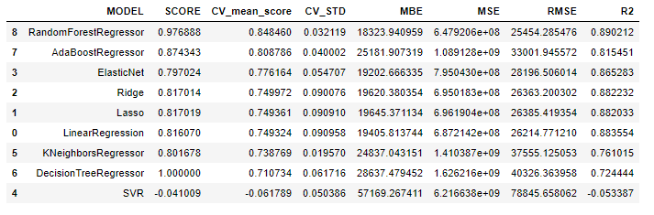
Metrics for Evaluation
Key metrics are Cross Validation score, R2 Score, MEAN ABSOLUTE ERROR, MEAN SQUARED ERROR and ROOT MEAN SQUARED ERROR

Slide 49
Key Metrics for success in solving problem under consideration
We can see two model scoring high in the chart Random Forest regressor and Decision tree model. Random forest regressor with model score of 97% but the Decision tree Regressor have the model score of 100%. However, we can see that in Decision Tree Regressor the CV score is only 71% which clearly says the Decision tree is over fitting with the data, on tuning with correct parameters the Decision Tree Regressor scores will reduce, but in the Random Forest regressor the CV score is 84.84% which is considerably better than Decision Tree Regressor.
So, basis on the same metrics I am choosing Random Forest Regressor as best across our models. Further we are going to visualize the performance of these models.

Slide 50
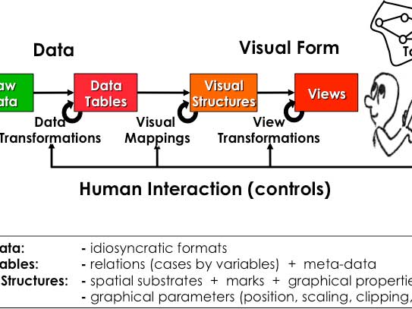
Model Visualization.
A visualization system is not just a system to create an image of the data but can be used to manipulate the data to create different types of images. A model of a visualization system should link the system with the model of scientific investigation discussed above.

Slide 51
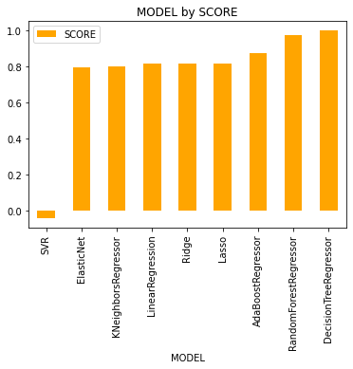
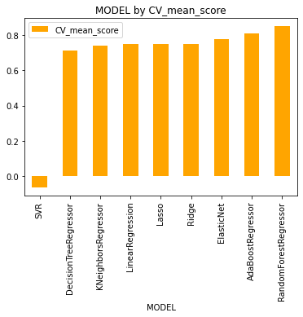
Model Visualization

Slide 52
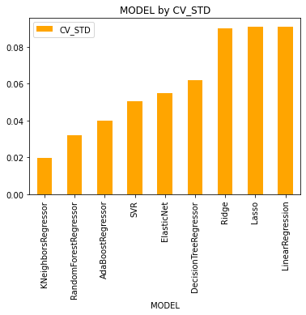
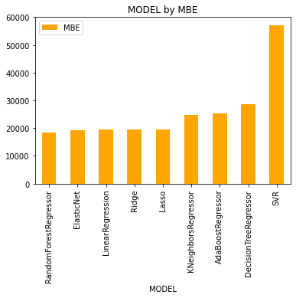
Model Visualization

Slide 53
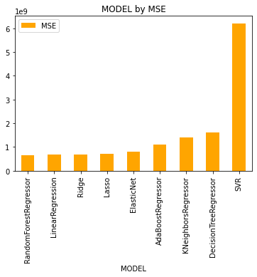
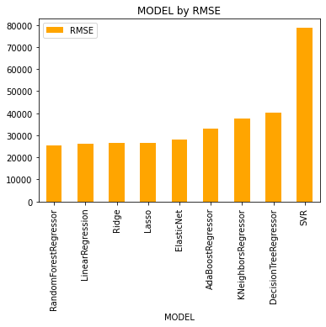
Model Visualization

Slide 54
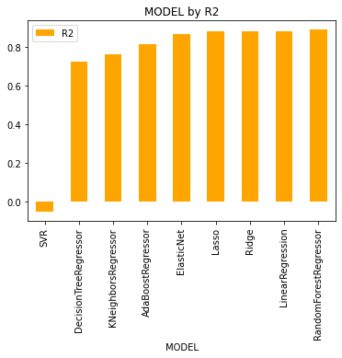
Model Visualization
From above we can see that Random Forest regressor and Decision tree regressor have high scores of 97% and 100% but cross validation average in Random Forest is 84% which is higher than 70% of Decision tree regressor. It is evident that Random Forest is the best model with Score of 0.97

Slide 55
Conclusion

Slide 56
Key Findings and Conclusions of the Study
1. What are the types of the building that are build most along with the foundation type and basement quality?
2. What is the most preferred type of neighbourhood.?
3. What are the other amenities that increases the cost of property.?
4. Which electrical systems are more preferred on the building?
5. What is Quality and the type of Fence, Garage, Heating systems that is mostly preferred.?
6. How many months old building sales type and sales conditions that increases the cost.?

Slide 57
Building types and attachments
As from the analysis we can surely say that 2-STORY 1946 & NEWER, 2-STORY 1945 & OLDER are the highly preferred dwellings with preferred near road access on Paved type roads. And also because of the lot availability slightly irregular lots are mostly preferred by the builders and also by the people. Lot Configuration the lot which is inside is slightly cheaper than the corner lot with gentle slope. These are the basic built type that comes out for sales more.
Builders and people mostly preferred a very strong foundation with a good quality foundation that are built with Stones and Poured Concrete are preferred more than the Cinder Block or Brick & Tile. And mostly depending on the construct of the building the cost of the foundation is also decided. Basement with Excellent (100+ inches) quality and also with Typical - slight dampness condition is sold most.

Slide 58
Neighborhood
There are 24 variety of neighborhood associated with the property mostly. But most preferred and costliest is Northridge and NorthPark Villa type neighborhood property with low density of people living are being costlier. The type of neighborhood will also define the safety, security and other immediate needs that can be fulfilled.

Slide 59
Amenities & Electric Systems:
At least fifty presents of the property have more amenities which increases the cost of the property amenities like Tennis Court is being the costliest and there are also other amenities such as Swimming pool, shed, elevator, 2ed garage.
Electric Systems plays a vital role in the safety of the houses and most preferred electrical systems are Standard Circuit Breakers & Romex that is mostly preferred and also being sold as costliest in the.

Slide 60
Sales type and Sales conditions of the property and Month Sold.
To build a property and sell it to the preferred customer it takes the marketing team at least of 9 – 10 months as per our above analysis so on a average the most property sold at more than 9 months but built lesser than 1 month are being the costliest.
Warranty Deed – Conventional with Home was not completed when last assessed (associated with New Homes) are being the costliest and normal sales conditioned property are sold higher.

Slide 61
Learning Outcomes of the Study in respect of Data Science
The above study helps one to understand the business of real estate. How the price is changing across the Properties.
With the Study we can tell how multiple real estate amenities like swimming pool, garage, pavement and lawn size of Lot Area, and type of Building raise decides the cost.
With the Study we can tell how multiple real estate amenities like swimming pool, garage, pavement and lawn size of Lot Area, and type of Building raise decides the cost.

Slide 62
The End
However, the required skills may often be absent across a good percentage of the industry. There is now the opportunity to learn these techniques and methods — specifically for real estate — and investing the time to upgrade could benefit a range of participants. Real estate researchers could begin to use data and machine learning to produce game-changing insights and unlock the value of large datasets. Those in the Protect industry (or even investing in Protect) could do well to understand these methods better and build (or invest in) disruptive activities. Finally, real estate investors who learn these methods could use data-driven approaches to find exceptional opportunities and beat the market.

